Slide 1
Department of Computer Science & Engineering
UE17CS355 – Web Tech II Laboratory
Project Evaluation
Project Title : Book Recommendation System
Project Team : PES1201701435 Harish P B
PES1201701608 Prince Jha
PES1201701102 Anagha M

Slide 2
Project Description
Book recommendation system that uses content based filtering to recommend books to the user based on the selected book
The user can add new book into the database
The user can check the lists of books in the database
The user can get recommendations similar to the selected book

Slide 3
Project Description
Home page Landing page of the website
Books page Lists all the books including their title, average_rating and image
Recommend page Displays the recommended books
Add Book page uses form to commit the new book to the database
Not Found page any other path displays that page not found

Slide 4





Technologies Used
Flask
React
SQL
React semantic UI
CSS

Slide 5
Techniques Implemented
FUNCTIONALITIES IMPLEMENTED
REST - Representational State Transfer in Flask
AJAX PATTERN - Multi stage download in React

Slide 6
Techniques Implemented
REST - Representational State Transfer
what is a REST API?
REST is a client server architecture
REST is stateless
REST is cacheable
REST provides a uniform interface between components
REST is a layered system

Slide 7
Techniques Implemented
Endpoints used
POST http://localhost:5000/books
List all the books in the database
GET http://localhost:5000/recommend/<title> Recommend books similar to <title>
POST http://localhost:5000/add_book
Submit the book data to be added into the database

Slide 8
Techniques Implemented
AJAX Pattern Multistage Download
The navigation bar is loaded initially on the page
The books are loaded in chunks
First say k books are loaded onto the page
Then after some time interval the next k books are loaded into the page and so on
Less load on server at point in time

Slide 9
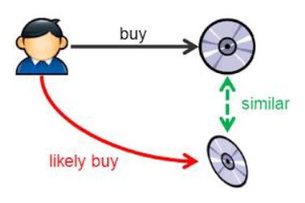
Intelligent Functionality
Content Based Recommendation System
Item descriptions to identify items that are of particular interest to the user
It relies on product features and textual item descriptions

Slide 10
Intelligent Functionality
Model
Load the data from the database
Represent each book as item vector
Represent the user preference as the profile vector
Transform text/features into TF-IDF vectors for each book
Used cosine similarity to calculate numeric value which
denotes the similarity between item and profile vectors
Recommends based on title, authors

Slide 11
Thank You

